Slide 1

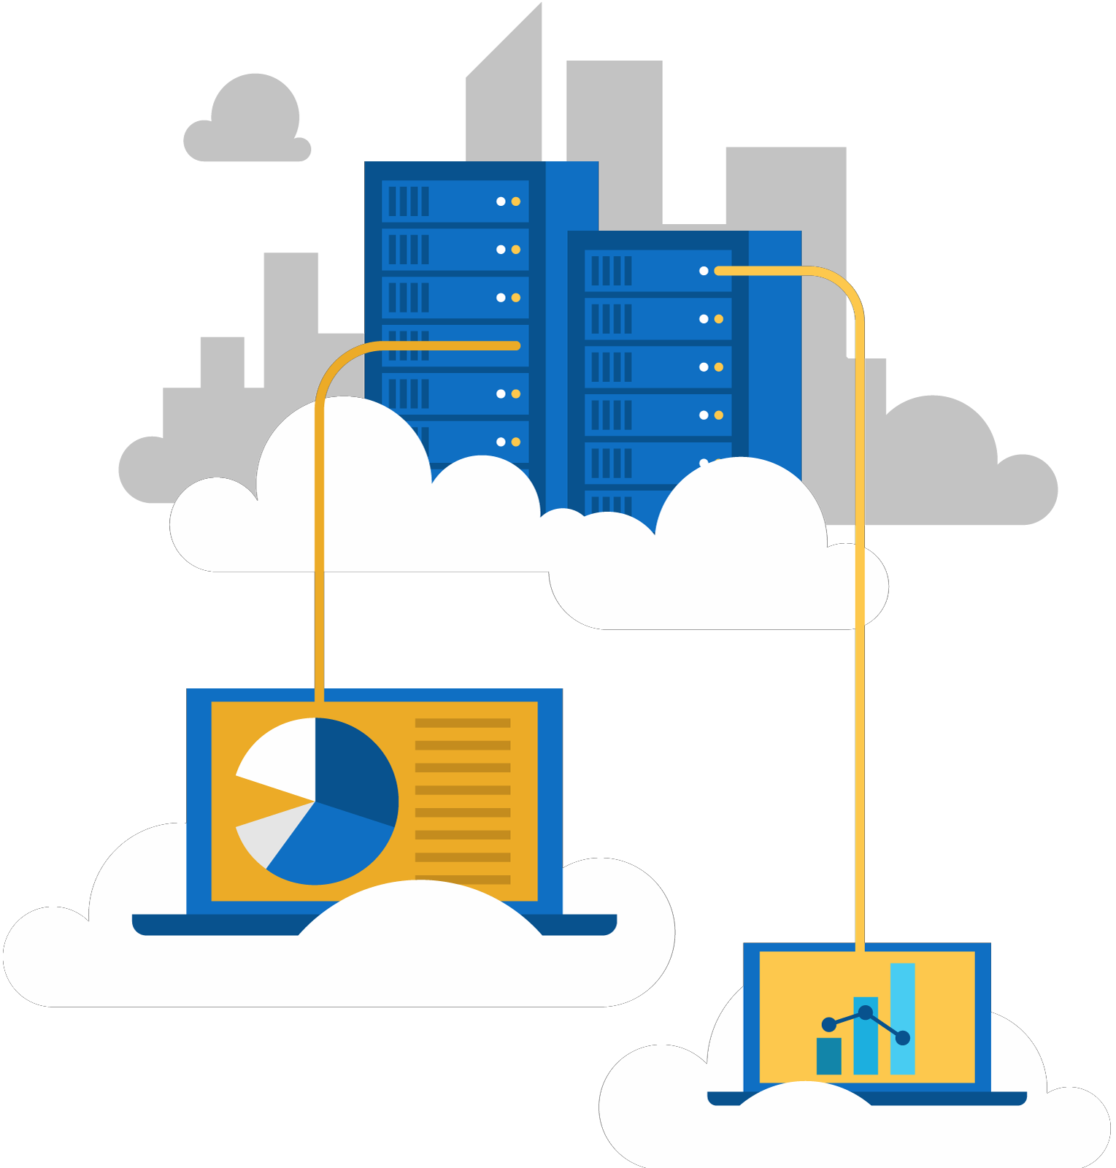




Jordan Radkov
Cloud Solution Architect

Slide 2

Design a Data Platform Solution (15-20%)

Slide 3
Series Agenda
1 | Determine Workload Requirements (10-15%)
2 | Design for Identity and Security (20-25%)
3 | Design a Data Platform Solution (15-20%)
4 | Design a Business Continuity Strategy (15-20%)
5 | Design for Deployment, Migration, and Integration (10-15%)
6 | Design an Infrastructure Strategy (15-20%)

Slide 4
Series Agenda
1 | Determine Workload Requirements (10-15%)
2 | Design for Identity and Security (20-25%)
3 | Design a Data Platform Solution (15-20%)
4 | Design a Business Continuity Strategy (15-20%)
5 | Design for Deployment, Migration, and Integration (10-15%)
6 | Design an Infrastructure Strategy (15-20%)

Slide 5

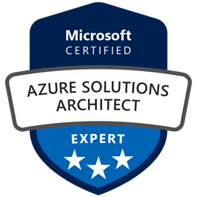
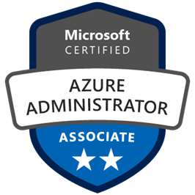
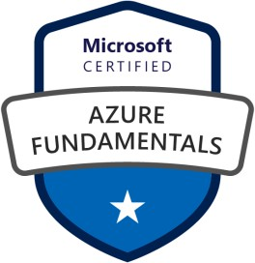



Jordan Radkov
Cloud Solution Architect based in the Munich
10+years in the industry in infrastructure administration , automation and now cloud
Constant learner - Ancora Imparo

Slide 6
Objectives
Design a Data Management Strategy
May include but not limited to: Choose between managed and unmanaged data store; choose between relational and non-relational databases; design data auditing and caching strategies; identify data attributes (e.g., relevancy, structure, frequency, size, durability, etc.); recommend Database Transaction Unit (DTU) sizing; design a data retention policy; design for data availability, consistency, and durability; design a data warehouse strategy
Design a Data Protection Strategy
May include but not limited to: Recommend geographic data storage; design an encryption strategy for data at rest, for data in transmission, and for data in use; design a scalability strategy for data; design secure access to data; design a data loss prevention (DLP) policy

Slide 7
Objectives (cont.)
Design and Document Data Flows
May include but not limited to: Identify data flow requirements; create a data flow diagram; design a
data flow to meet business requirements; design a data import and export strategy
Design a Monitoring Strategy for the Data Platform
May include but not limited to: Design for alert notifications; design an alert and metrics strategy

Slide 8
Design a Data Management Strategy

Slide 10


Slide 11


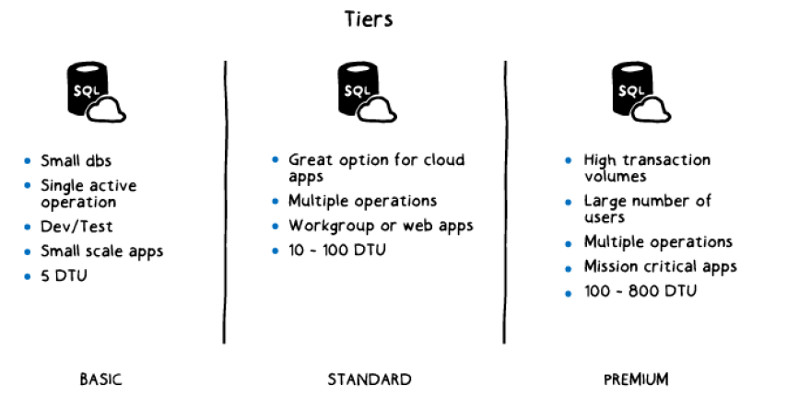



Slide 12


Slide 13
















Slide 14


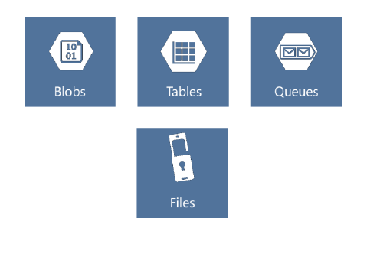







Slide 15






Slide 16


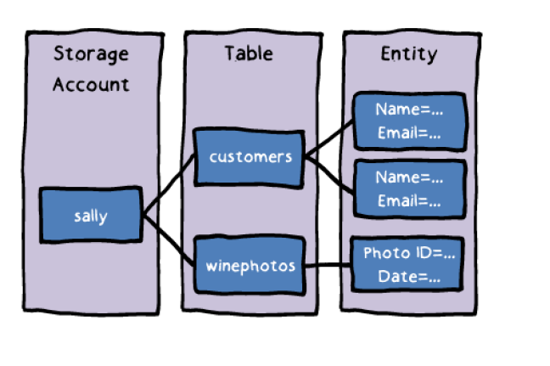







Slide 17





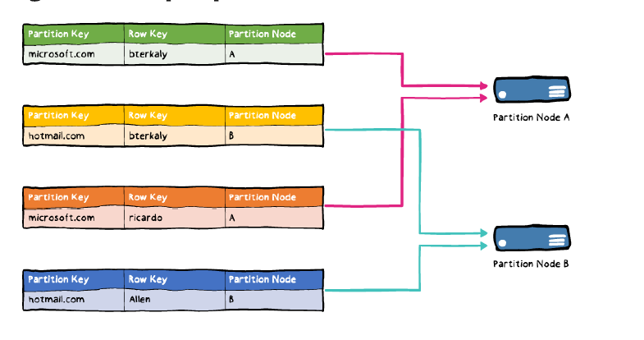



Slide 18


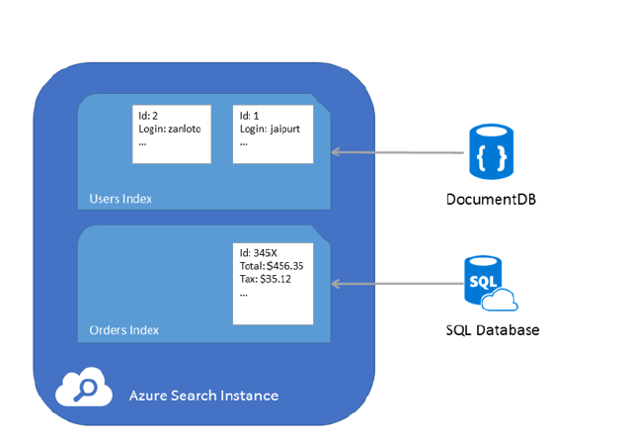








Slide 19


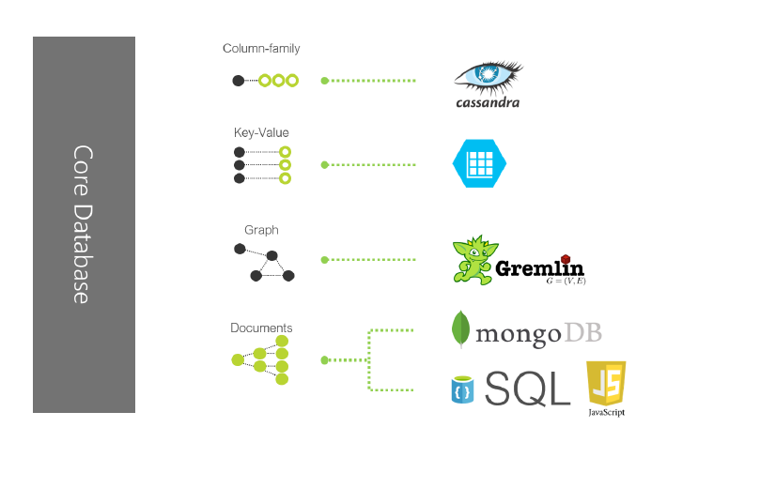




Slide 20





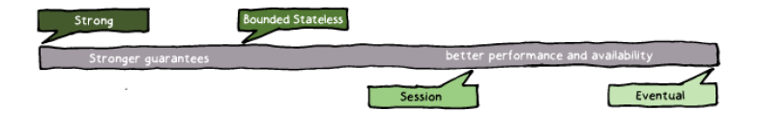

Slide 21


Slide 22
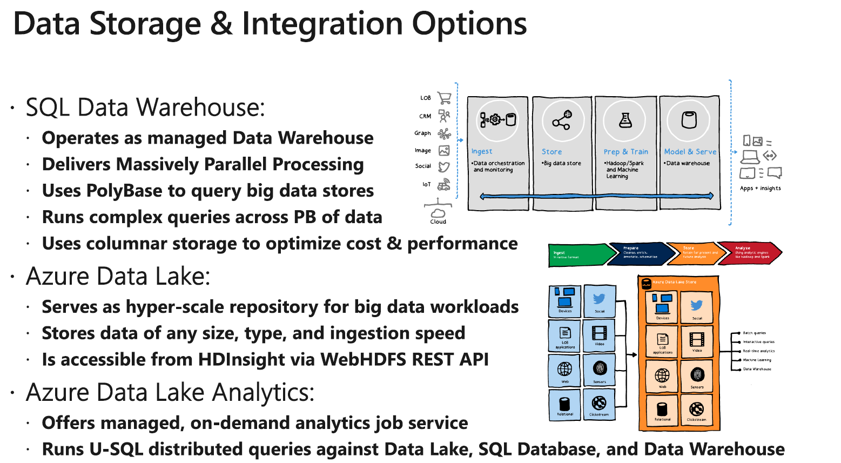









Slide 23
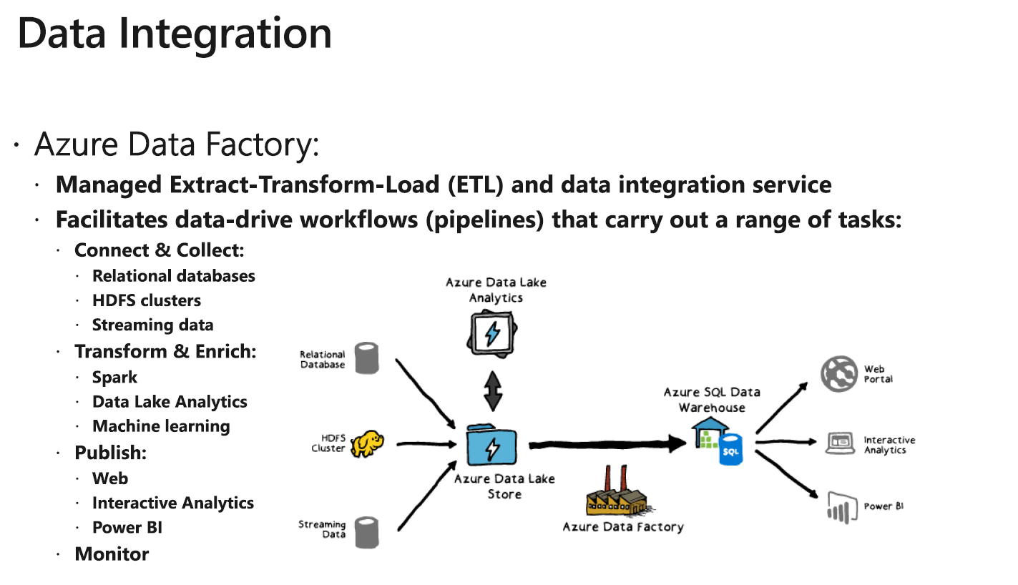













Slide 24
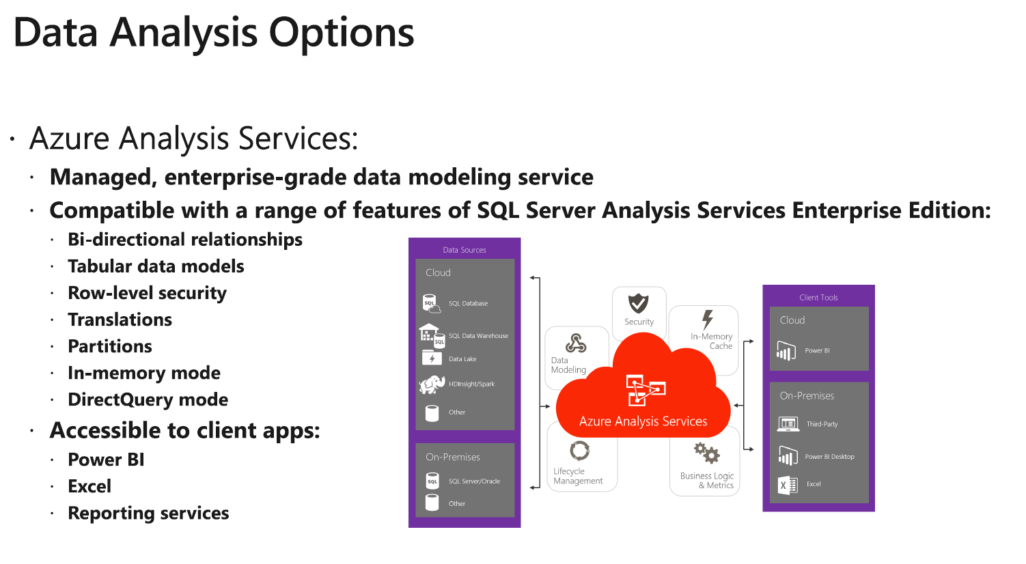












Slide 25
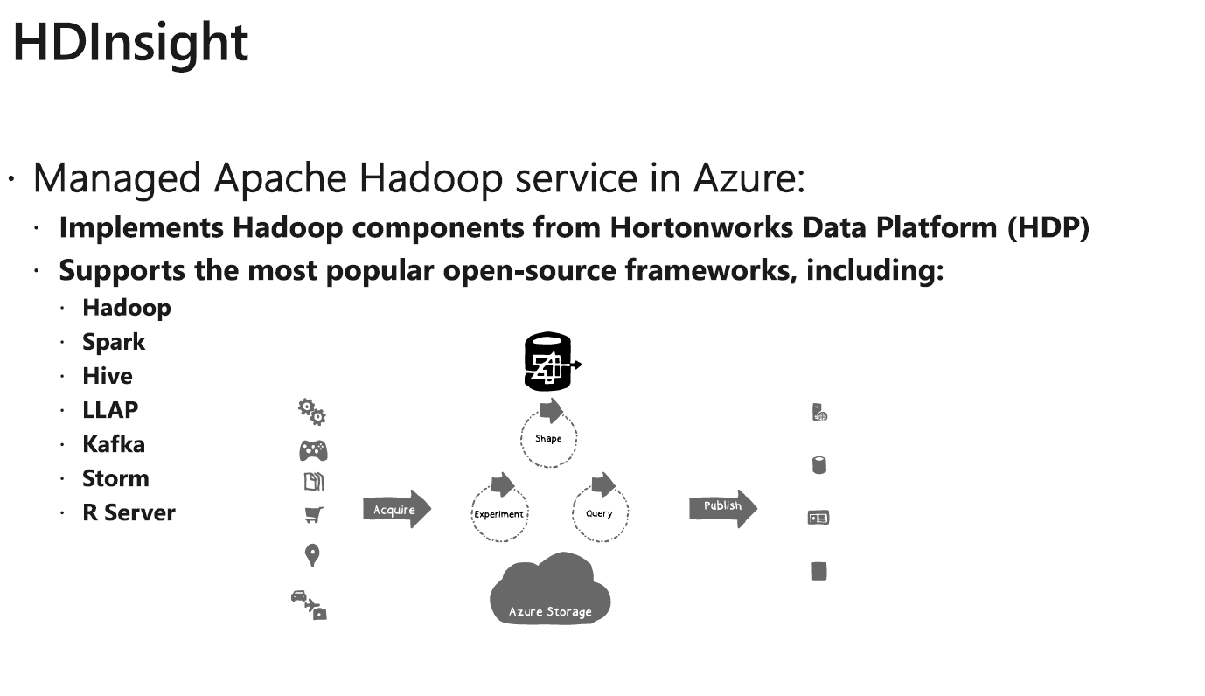








Slide 26


Slide 27
Design a Data Protection Strategy

Slide 28
Identity & access | Encryption | Secure networking | Partner solutions | Unified security management
RBAC Strong Authentication Monitoring and Alerting | Encryption Key Management Encryption at Rest and In Transit | Virtual Networks Traffic Rules Secure Connectivity | Antimalware Network Appliances Encryption Monitoring Application Security Authentication | Security Policy Monitoring Recommendations Threat Detection

Slide 29





Slide 30



Slide 31



Azure Key
Vault
Azure Active Directory
Key encryption keys
(KEKs)
Data encryption Keys (DEKs)
Resource providers

Slide 32




Slide 34



Slide 36
Code
App
App
Data
Operating system
Hypervisor
Hardware

Slide 37




Slide 38



Slide 39


Slide 40






Slide 41









Slide 42







Slide 43




Slide 44








Slide 45








Slide 46
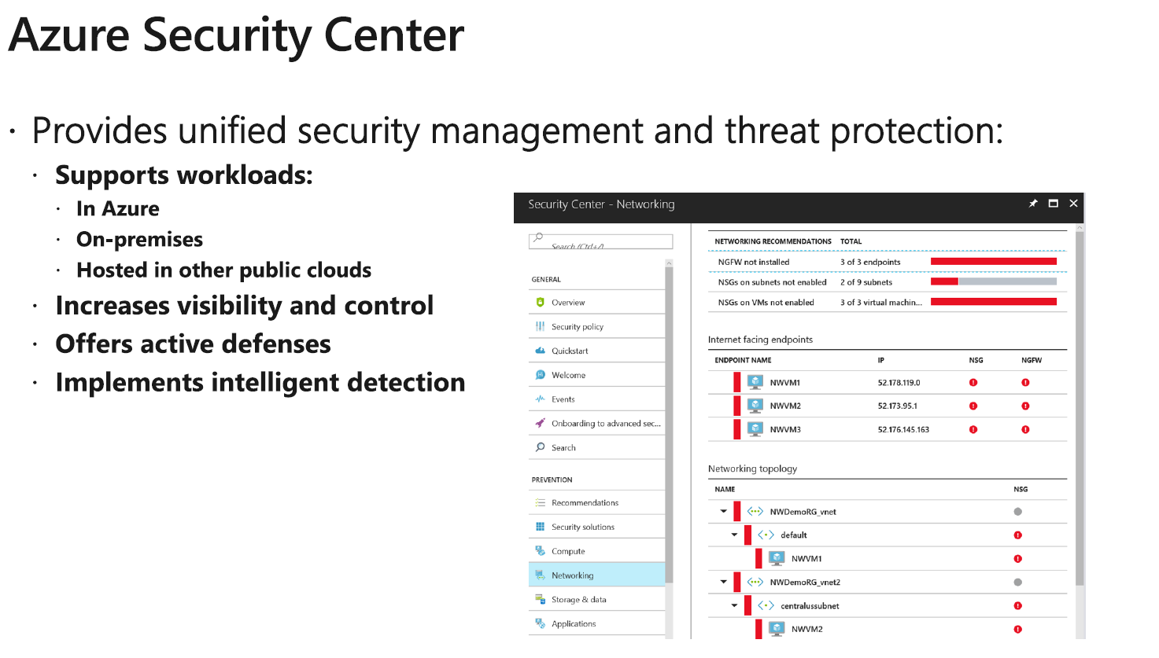




Slide 47



Slide 48



Slide 49
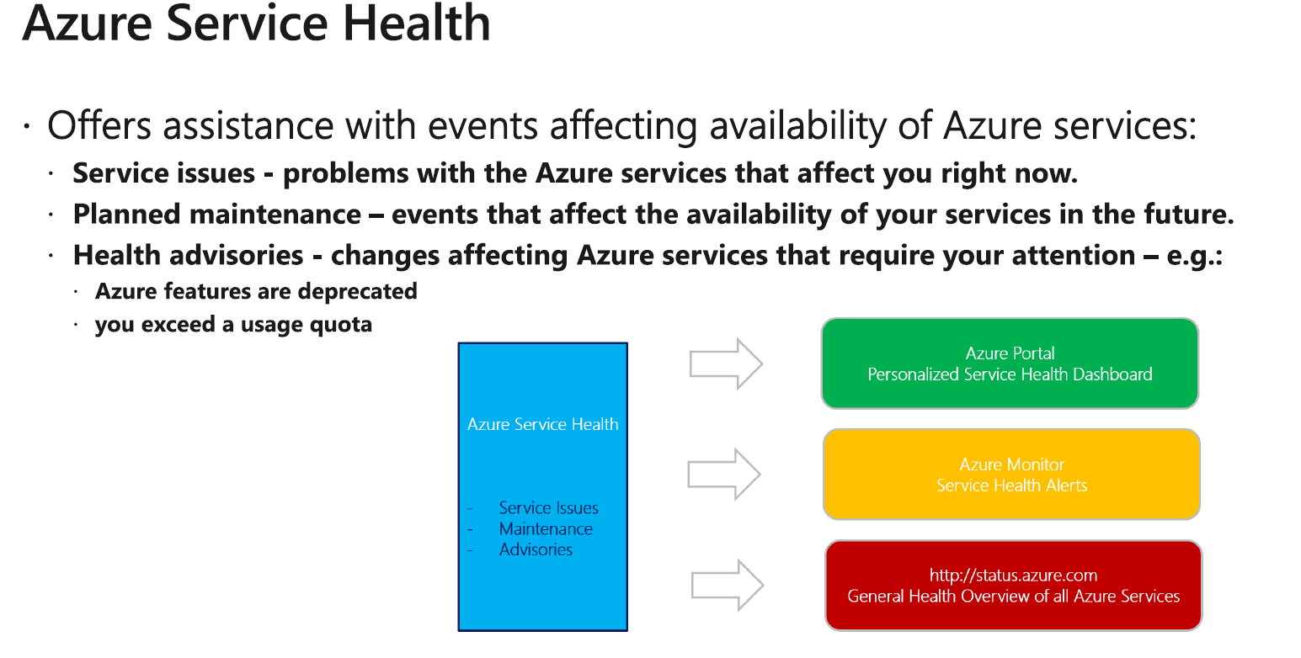



Slide 50




Slide 51
Application Insights
Extensible Application Performance Monitoring (APM) service:
Intended primarily for development and DevOps purposes
Supports apps:
In Azure
On-premises
Hosted in other public clouds
Provides:
Monitoring of live web apps Detection of performance anomalies App diagnostics
Usage analysis
Supports a wide range of development frameworks, including .NET, Node.js, and J2EE
Supports mobile apps by integrating with Visual Studio App Center and HockeyApp

Slide 52

Questions?

